Slide 1
CHAP TER 7: PRIVACY
DR. ROZI NOR HAIZAN BINTI NOR

Slide 2

Objectives
Define privacy
Know threat to privacy
Know how to protect privacy

Slide 3
Introduction
Information collection, exchange, combination, and distribution easier than ever
More information access → less privacy
Trade-offs
Privacy vs need for credentials
Privacy vs desire for free expression
Privacy vs safety/security

Slide 4
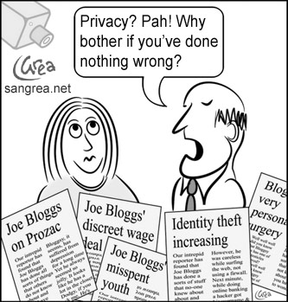
Definition
The right of privacy
- the right to be left alone
The right of individuals to control the collection and use of information about themselves

Slide 5
Definition (cont..)
Key aspects
1) freedom from intrusion – being left alone
2) control of information about oneself
3) freedom from surveillance (from being followed, watched, and eavesdropped)

Slide 6
Harms of privacy
Too much individual privacy can harm society
Cover for illegal or immoral activities
Burden on the nuclear family
Hidden dysfunctional families
Ignored people on society’s fringes

Slide 7
Benefits of privacy
Individual growth
Individual responsibility
Freedom to be yourself
Intellectual and spiritual growth
Development of loving, trusting, caring, intimate relationship

Slide 8
Risks of the technology
Invisible information gathering
- collection of personal information about someone without the person’s knowledge.
Ethical issue is :
- if someone is not aware that the information is being collected or how it will be used, he or she has no opportunity to consent or withhold consent for its collection and use.

Slide 9
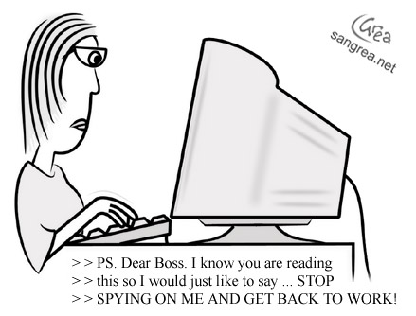
Risks of the technology (cont..)
Satellite surveillance
Automatic identification of a person’s telephone number for toll free call
Supermarket club cards
ISP knows every site we visit
Cookies

Slide 10
Risks of the technology (cont..)
Secondary use of personal information
- use of information for a purpose other than the one for which it was supplied.
- difficult for us to control our personal information if it is collected by business, organization and share with or sold to others
- eg. Sale of consumer information to marketers or other business, use of information to deny job, deny bank loan (eg: CTOS –Credit Tip Off Service Sdn. Bhd)
Notes:
For examples:
Why is Information Used to Deny Jobs or Loans
For employers: A poor financial history might indicate unreliability, especially for roles handling money or sensitive information.
For banks: A low credit score or a history of defaults signals a higher risk of loan default.

Slide 11
Risks of the technology (cont..)
Computer matching
- combining and comparing information from different databases
- eg businesses use the technique to form consumer dossiers, government uses to detect fraud
Computer profiling
- using data in computer files to determine characteristics of people most likely to engage in certain behavior
- eg determination of customers for specific product
Notes:
Computer matching (compare data sets for consistency) and computer profiling (create detailed profiles or predictions about ind/group), while useful for analyzing data and making decisions, can have significant implications for privacy. Such as data misuse, over collection, lack of transparency, false matches and bias
Computer matching for fraud detection, verification application
Computer profiling for marketing, risk assessment, decision making application

Slide 12
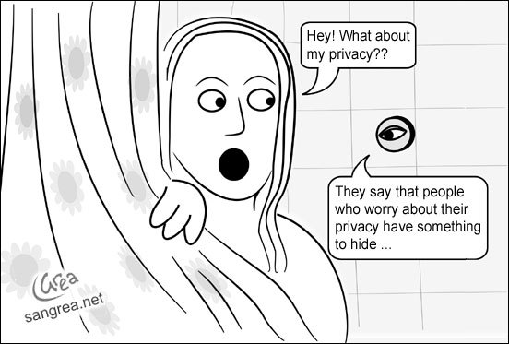
Risks of the technology (cont..)
Location
many devices allow our location to be determined
eg. GPS, satellite, computer chip, wireless watchband transmitter

Slide 13
Case Study: Secret Monitoring
Sullivans have a baby girl
Both work; they are concerned about performance of full-time nanny
Purchase program that allows monitoring through laptop’s camera placed in family room
They do not inform nanny she is being monitored

Slide 14
Rule Utilitarian Evaluation
If everyone monitored nannies, it would not remain a secret for long
Consequences
Nannies would be on best behavior in front of camera
Might reduce child abuse and parents’ peace of mind
Would also increase stress and reduce job satisfaction of child care providers
Might result in higher turnover rate and less experienced pool of nannies, who would provide lower-quality care
Harms appear greater than benefits, so we conclude action was wrong

Slide 15
Social Contract Theory Evaluation
It is reasonable for society to give people privacy in their own homes
Nanny has a reasonable expectation that her interactions with baby inside home are private
Sullivan’s decision to secretly monitor the nanny is wrong because it violates her privacy

Slide 16
Kantian Evaluation
Imagine rule, “An employer may secretly monitor the work of an employee who works with vulnerable people”
If universalized, there would be no expectation of privacy by employees, so secret monitoring would be impossible
Proposed rule is self-defeating, so it is wrong for Sullivans to act according to the rule

Slide 17
Summary
Three analyses have concluded Sullivans were wrong to secretly monitor how well their nanny takes care of their baby
Morally acceptable options
Conduct more comprehensive interview of nanny
More thoroughly check nanny’s references
Spend a day or two at home observing nanny from a distance
Be up-front with nanny about desire to install and use surveillance software on laptop

Slide 18
Disclosing Information
Personal
information
Public
information
Public
record

Slide 19
Disclosing Information
Public record : information for public access. Eg birth certificate, marriage licenses, motor vehicle records, criminal record
Public information : information revealed to an organization that has right to share it. Eg telephone directory
Personal information : undisclosed information

Slide 20
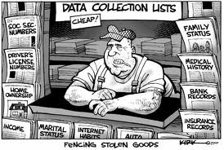
Data Gathering and Privacy Implications
Facebook tags
Enhanced 911 services
Rewards or loyalty programs
Body scanners
RFID tags
Implanted chips
Cookies and flash cookies
Etc.

Slide 21
Facebook Tags
Tag: Label identifying a person in a photo
Facebook allows users to tag people who are on their list of friends
About 100 million tags added per day in Facebook
Facebook uses facial recognition to suggest name of friend appearing in photo
Does this feature increase risk of improper tagging?

Slide 22
Enhanced 911 Services
Cell phone providers in United States required to track locations of active cell phones to within 100 meters
Allows emergency response teams to reach people in distress
What if this information is sold or shared?

Slide 23
Rewards or Loyalty Programs
Shoppers who belong to store’s rewards program can save money on many of their purchases
Computers use information about buying habits to provide personalized service
ShopRite computerized shopping carts with pop-up ads
Do card users pay less, or do non-users get overcharged?

Slide 24
Body Scanners
Some department stores have 3-D body scanners
Computer can use this information to recommend clothes
Scans can also be used to produce custom-made clothing

Slide 25
Body Scanner Takes Measurements
AP Photo/Richard Drew

Slide 26
RFID Tags
RFID: Radio frequency identification
An RFID tag is a tiny wireless transmitter
Manufacturers are replacing bar codes with RFID tags
Contain more information
Can be scanned more easily
If tag cannot be removed or disabled, it becomes a tracking device

Slide 27
Implanted Chips
Taiwan: Every domesticated dog must have an implanted microchip
Size of a grain of rice; implanted into ear
Chip contains name, address of owner
Allows lost dogs to be returned to owners
RFID tags approved for use in humans
Can be used to store medical information
Can be used as a “debit card”

Slide 28
Digital Video Recorders
TiVo service allows subscribers to record programs and watch them later
TiVo collects detailed information about viewing habits of its subscribers
Data collected second by second, making it valuable to advertisers and others interested in knowing viewing habits

Slide 29
Cookies
Cookie: File placed on computer’s hard drive by a Web server
Contains information about visits to a Web site
Allows Web sites to provide personalized services
Put on hard drive without user’s permission
You can set Web browser to alert you to new cookies or to block cookies entirely

Slide 30
Flash Cookies
Flash cookie: File placed on your computer’s hard drive by a Web server running the Adobe Flash Player
Flash cookie can hold 25 times as much information as a browser cookie
Flash cookies not controlled by browser’s privacy controls
Some Web sites use flash cookies as a way of backing up browser cookies. If you delete browser cookie, it can be “respawned” from the flash cookie
Half of 100 most popular Web sites use flash cookies

Slide 31
Disclosing Information
Types of disclosures:
- Voluntary
- Involuntary
- Statutory

Slide 32
Principles for data collection and use
Informed consent
- business and organization must inform consumers about what information they are collecting and how they will use it
Offer a way for people to opt out from mailing lists and from transfer of their data to other parties
Provide stronger protection for sensitive data. Eg: use an opt in policy for disclosure of medical data

Slide 33
Principles for data collection and use
Collect only the data needed
Keep data only as long as needed
Maintain accuracy and security of data
Provide a way for people to access and correct data stored about them
Sanction against employees who release information without authorization

Slide 34
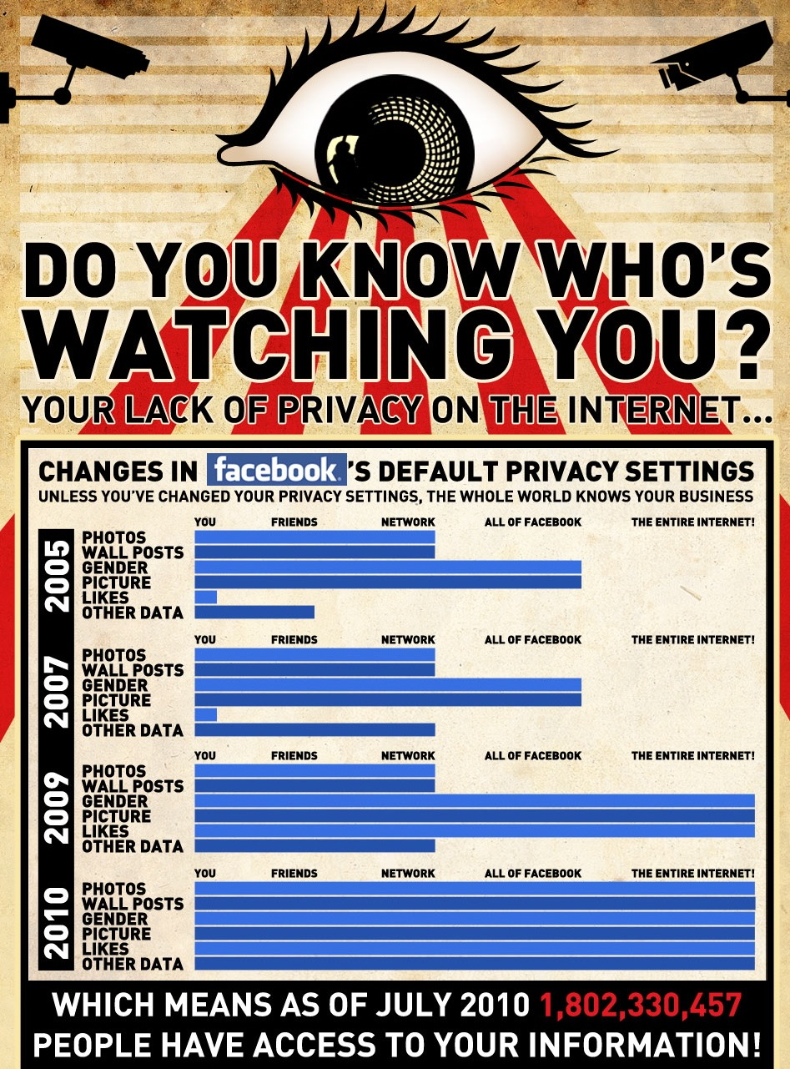
Privacy protection
Awareness
how technology works
how it is being used
what the risks are
what tools are available to reduce exposure and unwanted uses of personal data

Slide 35
Privacy protection
Awareness as consumers
decide to what extent to use privacy protection tools
be more careful about information given out
consider the privacy policies of business and web sites we use or visit

Slide 36
Privacy protection
Awareness as business managers
learn and implement techniques to respond to the privacy demands of consumers
Awareness as computer professional
design database systems/web software that make it easier to build in privacy protection and reduce the risks of unauthorized leaks

Slide 37
Privacy protection
Privacy-Enhancing Technologies
cookie disablers
alerting users whenever a web site is about to store a cookie and allow them to reject it
surfing web anonymously, leaving no record of visiting site; Anonymizer.com

Slide 38
Privacy protection
Privacy-Enhancing Technologies
Platform for Privacy Protection (P3P) ‘automatically’ protect privacy by user specifying his/her privacy requirement
a well-designed database to protect leak, intruders, unauthorized access
=> restriction of operation
=> audit trail to trace unauthorized
activities
=> encrypted information

Slide 39
Privacy protection
Trusted Third Parties
- firms whose reputation for honesty is important to their business to process confidential data
Paying for Consumer Information
- willing to trade some privacy for other things
Explicit policy statement
Opt in opt out policy

Slide 40
Privacy protection
Market Response
market can protect privacy by:
=> using trusted third parties
=> adhering to established privacy
policy
=> purchasing consumer information
directly from the consumers
=> developing and selling privacy-enhancing
technology and services

Slide 41
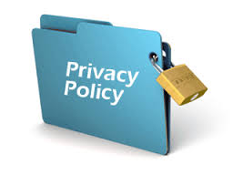
Privacy protection: Regulation
Basic legal framework
=> enforcement of agreements and contracts
freedom to create them and enforcement of their terms by the legal system
=> publish privacy policy

Slide 42
Privacy protection: Regulation
Basic legal framework
=> set privacy-protection default not in
contracts
information could be used only for the direct and obvious purpose for which it was supplied

Slide 43
Privacy protection: Regulation
Requiring specific consent policies
=> adhere to informed consumer consent
must clearly state policy for use of personal information. If a person proceeds and purchase, explores the web sites, provides information, and so on, consent to the policy is assumed
must provide an opt out policy
must use an opt in policy
must obtain consent for each individual secondary use, disclosure, or transfer of their personal information

Slide 44

Maybank2u
Privacy Policy
Our customers have always been our top priority and the Maybank Group is dedicated to ensuring that our online financial transactions are private, safe and secure. In short, your privacy is our top priority.
This privacy policy is designed to explain some of the privacy principles we abide by, in providing a responsible and reliable online experience

Slide 45
Maybank2u
Sharing Information
The only other instances where we disclose your information is:
When it is required by law When such disclosure is required under legislation or regulation, government agency or court order.
When it involves public interest When such disclosure is required to protect the interest of the public, for example in the detection of crimes, etc.
Where it is authorized by you

Slide 46
Discussion Question
Music files downloaded from Apple’s iTunes Store have the purchaser’s name and email address embedded in them. Conceivably, Apple could use this information to learn how much file sharing goes on (e.g., it could find out that a month after Ann purchases a song there are 10 computers that have a copy of Ann’s music file)
By including personal information in music files it sells, has Apple violated the privacy rights of its customers?

